Slide 1

Catch a third wave
Jakolien den Hollander & Laura Dell’Antonio
Notes:
problem statement (goal)
evaluation metrics (user perspective)
proposed timeline (as proposed at the beginning) plus where is one on the timeline
current findings about the data/EDA
approaches and current results wrt goal
future work

Slide 2
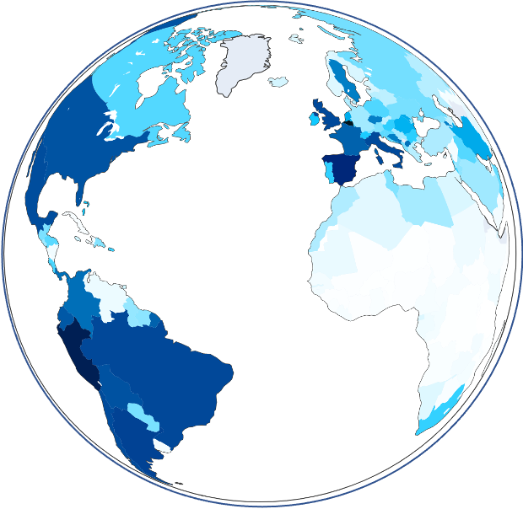
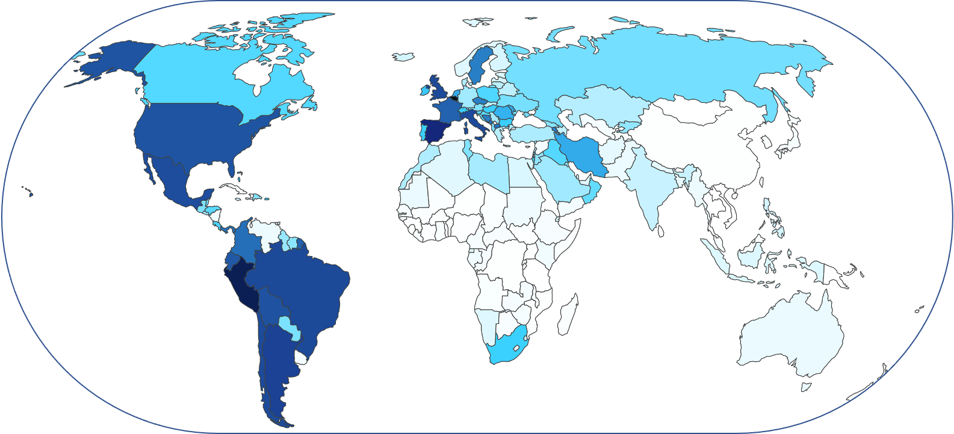
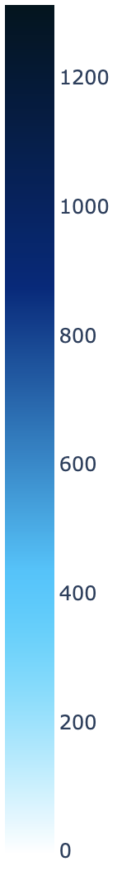
TOTAL COVID-19 DEATHS PER MILLION
Notes:
State: 19 November 2020
Most deaths in Peru
Probably for some countries more accurate than for others.
No data on: Turkmenistan, Mongolia, North Korea, Cambodia, Laos and maybe some Island states or city states (and this map doesn’t show Greenland but we also don’t have data on Greenland)

Slide 3
—DR. TEDROS ADHANOM GHEBREYESUS, WORLD HEALTH ORGANIZATION’S DIRECTOR GENERAL
“We cannot say this loudly enough or clearly enough or often enough: All countries can still change the course of this pandemic”

Slide 4
HOW?
MASK WEARING
SOCIAL DISTANCING
Effective measures to flatten the curve?
A global comparison.

Slide 5
GOAL
Increase awareness of the impact of mask wearing and social distancing on the number of COVID-19 cases world wide.
What is the course of the pandemic for:
More adhering populations
Less adhering populations.
Notes:
Important not to under- or over-predict.
Under-predicting means people won’t do as advised.
Over-predicting means people fear unnecessarily.

Slide 6
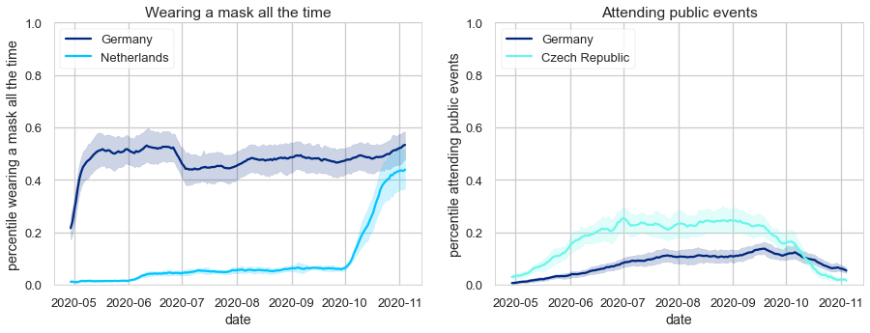
ADHERING TO MEASURES
Notes:
Czech Republic attended public events twice as much as Germany.

Slide 7
MASK WEARING REQUIREMENTS
No
Yes
Notes:
Different countries have different requirements. Here you can see the requirement wearing masks everywhere in public. Orange is no measure in place, whereas green means there is. In Africa, a lot of countries have a requirement to wear mask everywhere in public. This is not the case in countries with the highest requirements.
Whereas for countries with very high HDIs (above 0.8), a very low percentage have tha requirement

Slide 8
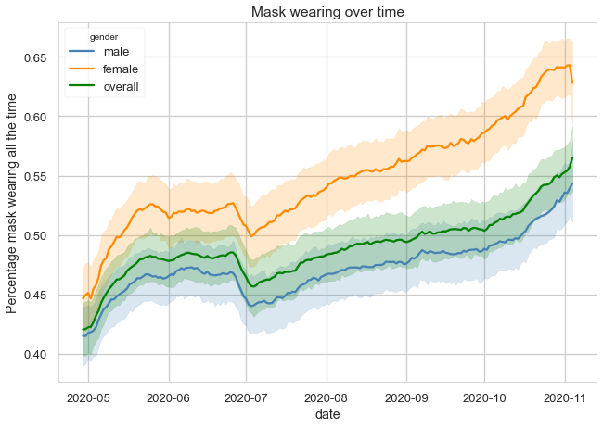
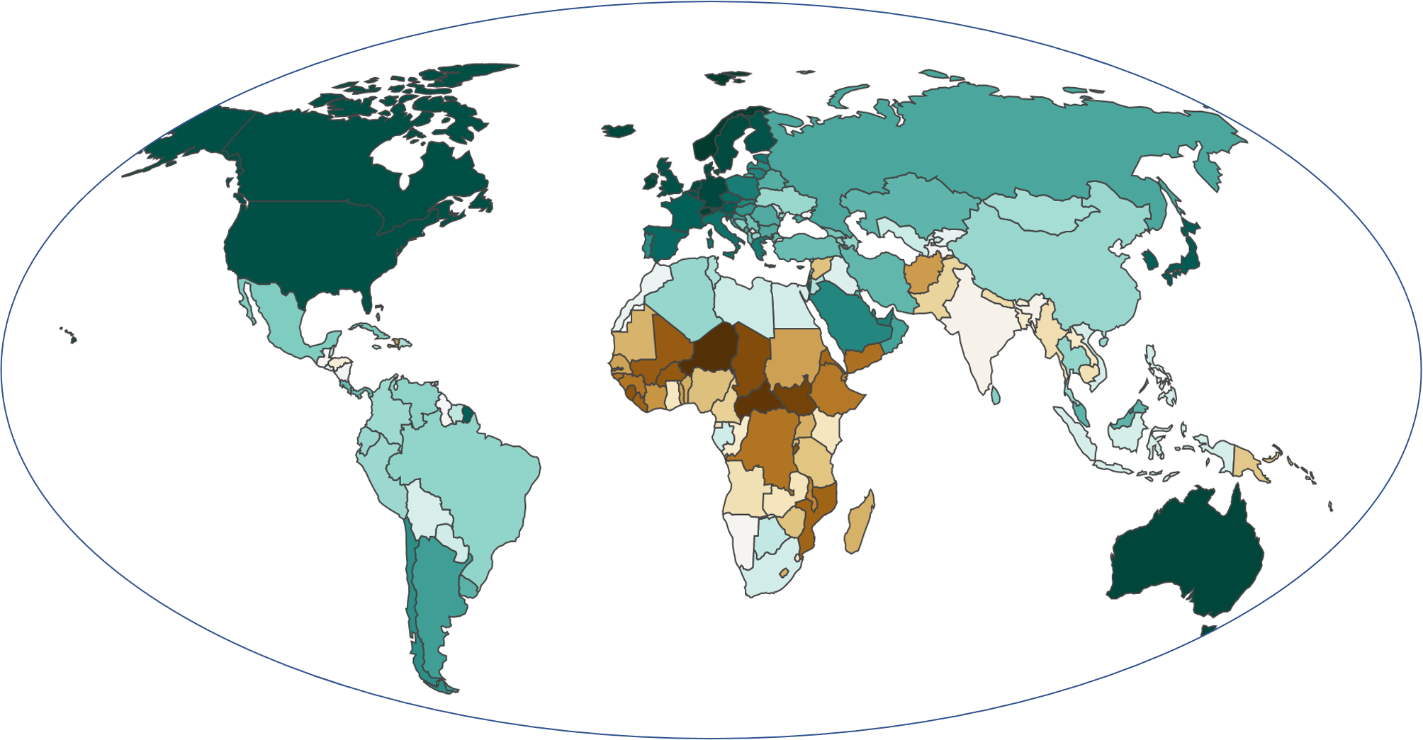
FACTORS: MASK-WEARING
DATE & GENDER
HDI
Notes:
Date - beginning some, summer sloppy, second wave twice as many people wearing masks
Gender - males sloppier mask wearing
The Human Development Index (HDI) is a summary measure of average achievement in key dimensions of human development: a long and healthy life, being knowledgeable and have a decent standard of living.
ASIA higher HDI the more people wear masks
Europe - higher HDI fewer wear masks
Worldwide - more people never wear mask for HDI below 0.55 and above 0.9

Slide 9

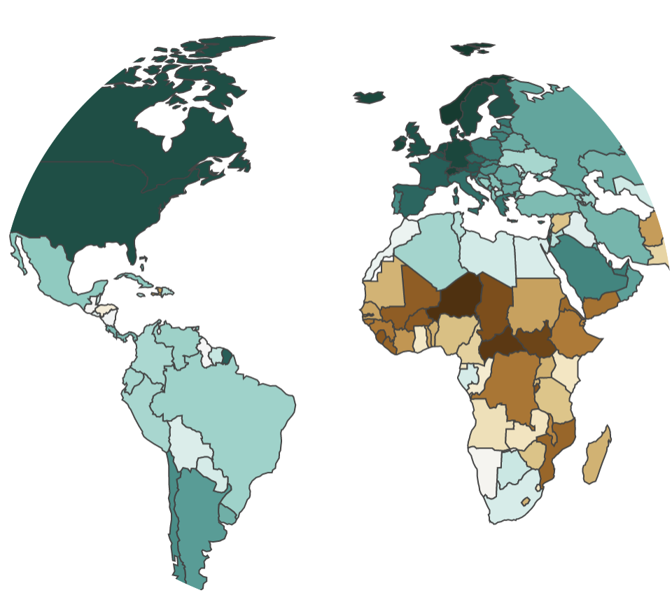




FACTORS: SOCIAL DISTANCING
GENDER
AGE
DATE
HDI
Notes:
HDI, e.g.
Working outside home (higher HDI less)
Public transport (higher HDI less)
Difference between men and women a lot bigger in low HDI countries
In general high

Slide 10
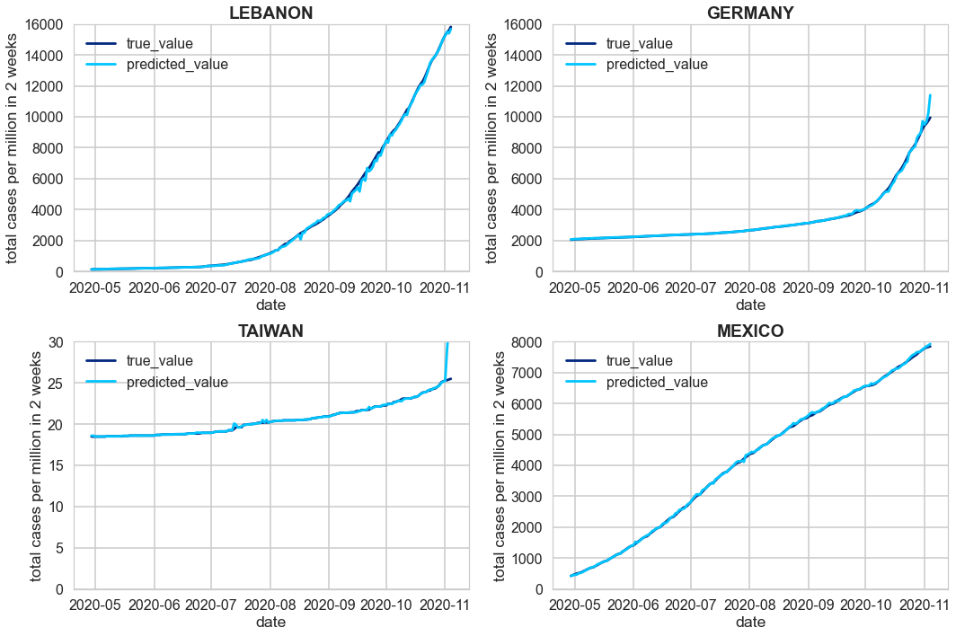
FINDINGS
Predict the number of COVID-19 cases in a country two weeks in advance.
Error rate of 3.7%.

Slide 11
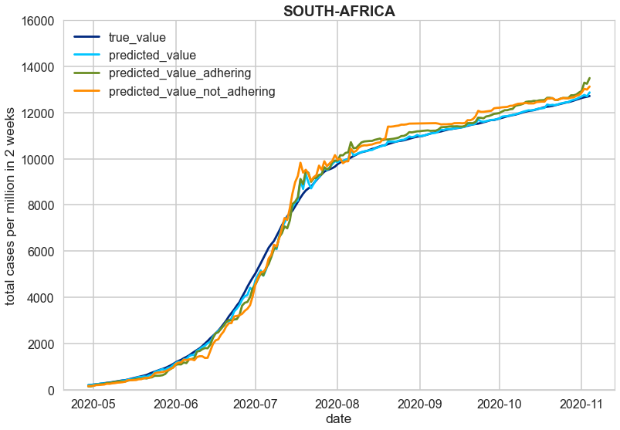
FINDINGS
How does changing measures regarding mask wearing or social distancing affect the course of the pandemic for a country?
Two weeks in advance.
80% / 20% 80% / 20%
Not yet reliable.

Slide 12
DASHBOARD
Interactive dashboard with a drop down menu to visualise different data. E.g.:
Number of COVID cases per million
Percentage of people wearing masks
https://catch-a-third-wave.herokuapp.com/

Slide 13

THANKS!

Slide 14
TIMELINE
WEEK 03
WEEK 01
Modelling data,
Interactive Dashboard
Understanding data
WEEK 02
WEEK 04
Visualizing data
Modelling,
Finalising Project

